Slide 1
THE IMMUNE SYSTEM & Bloodborne pathogens
5th Grade

Slide 2
Why We teach about HIV/AIDS?
The Pennsylvania Board of Education has mandated that schools offer instruction as part of the ongoing health curriculum during their education.
As per state guidelines,any student may be excused from instruction about HIV/AIDS if a written request is furnished by the student’s parent/guardian.
A letter of dates with instruction will be posted on the building’s webpage prior to the start of the classes. Dates will also be on the nurse’s webpage.

Slide 3
Class Content
Introduction to the Immune System and terminology
Introduction to Bloodborne Pathogens, especially focusing on HIV/AIDS
How to protect oneself from Bloodborne Pathogens

Slide 4
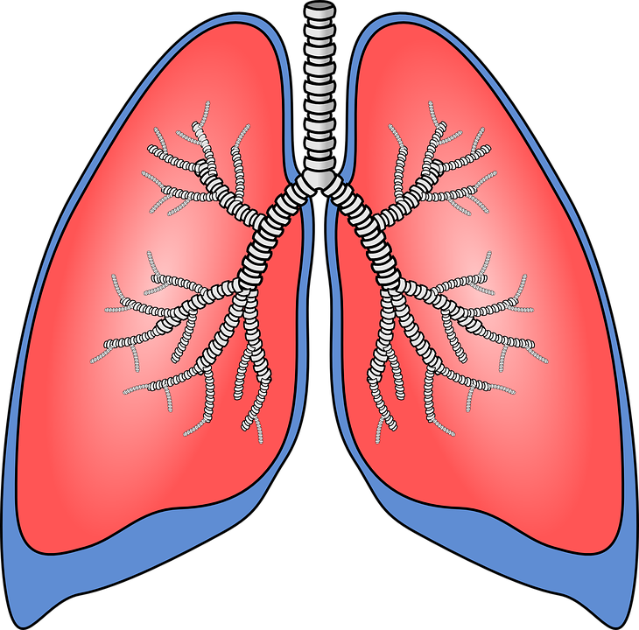
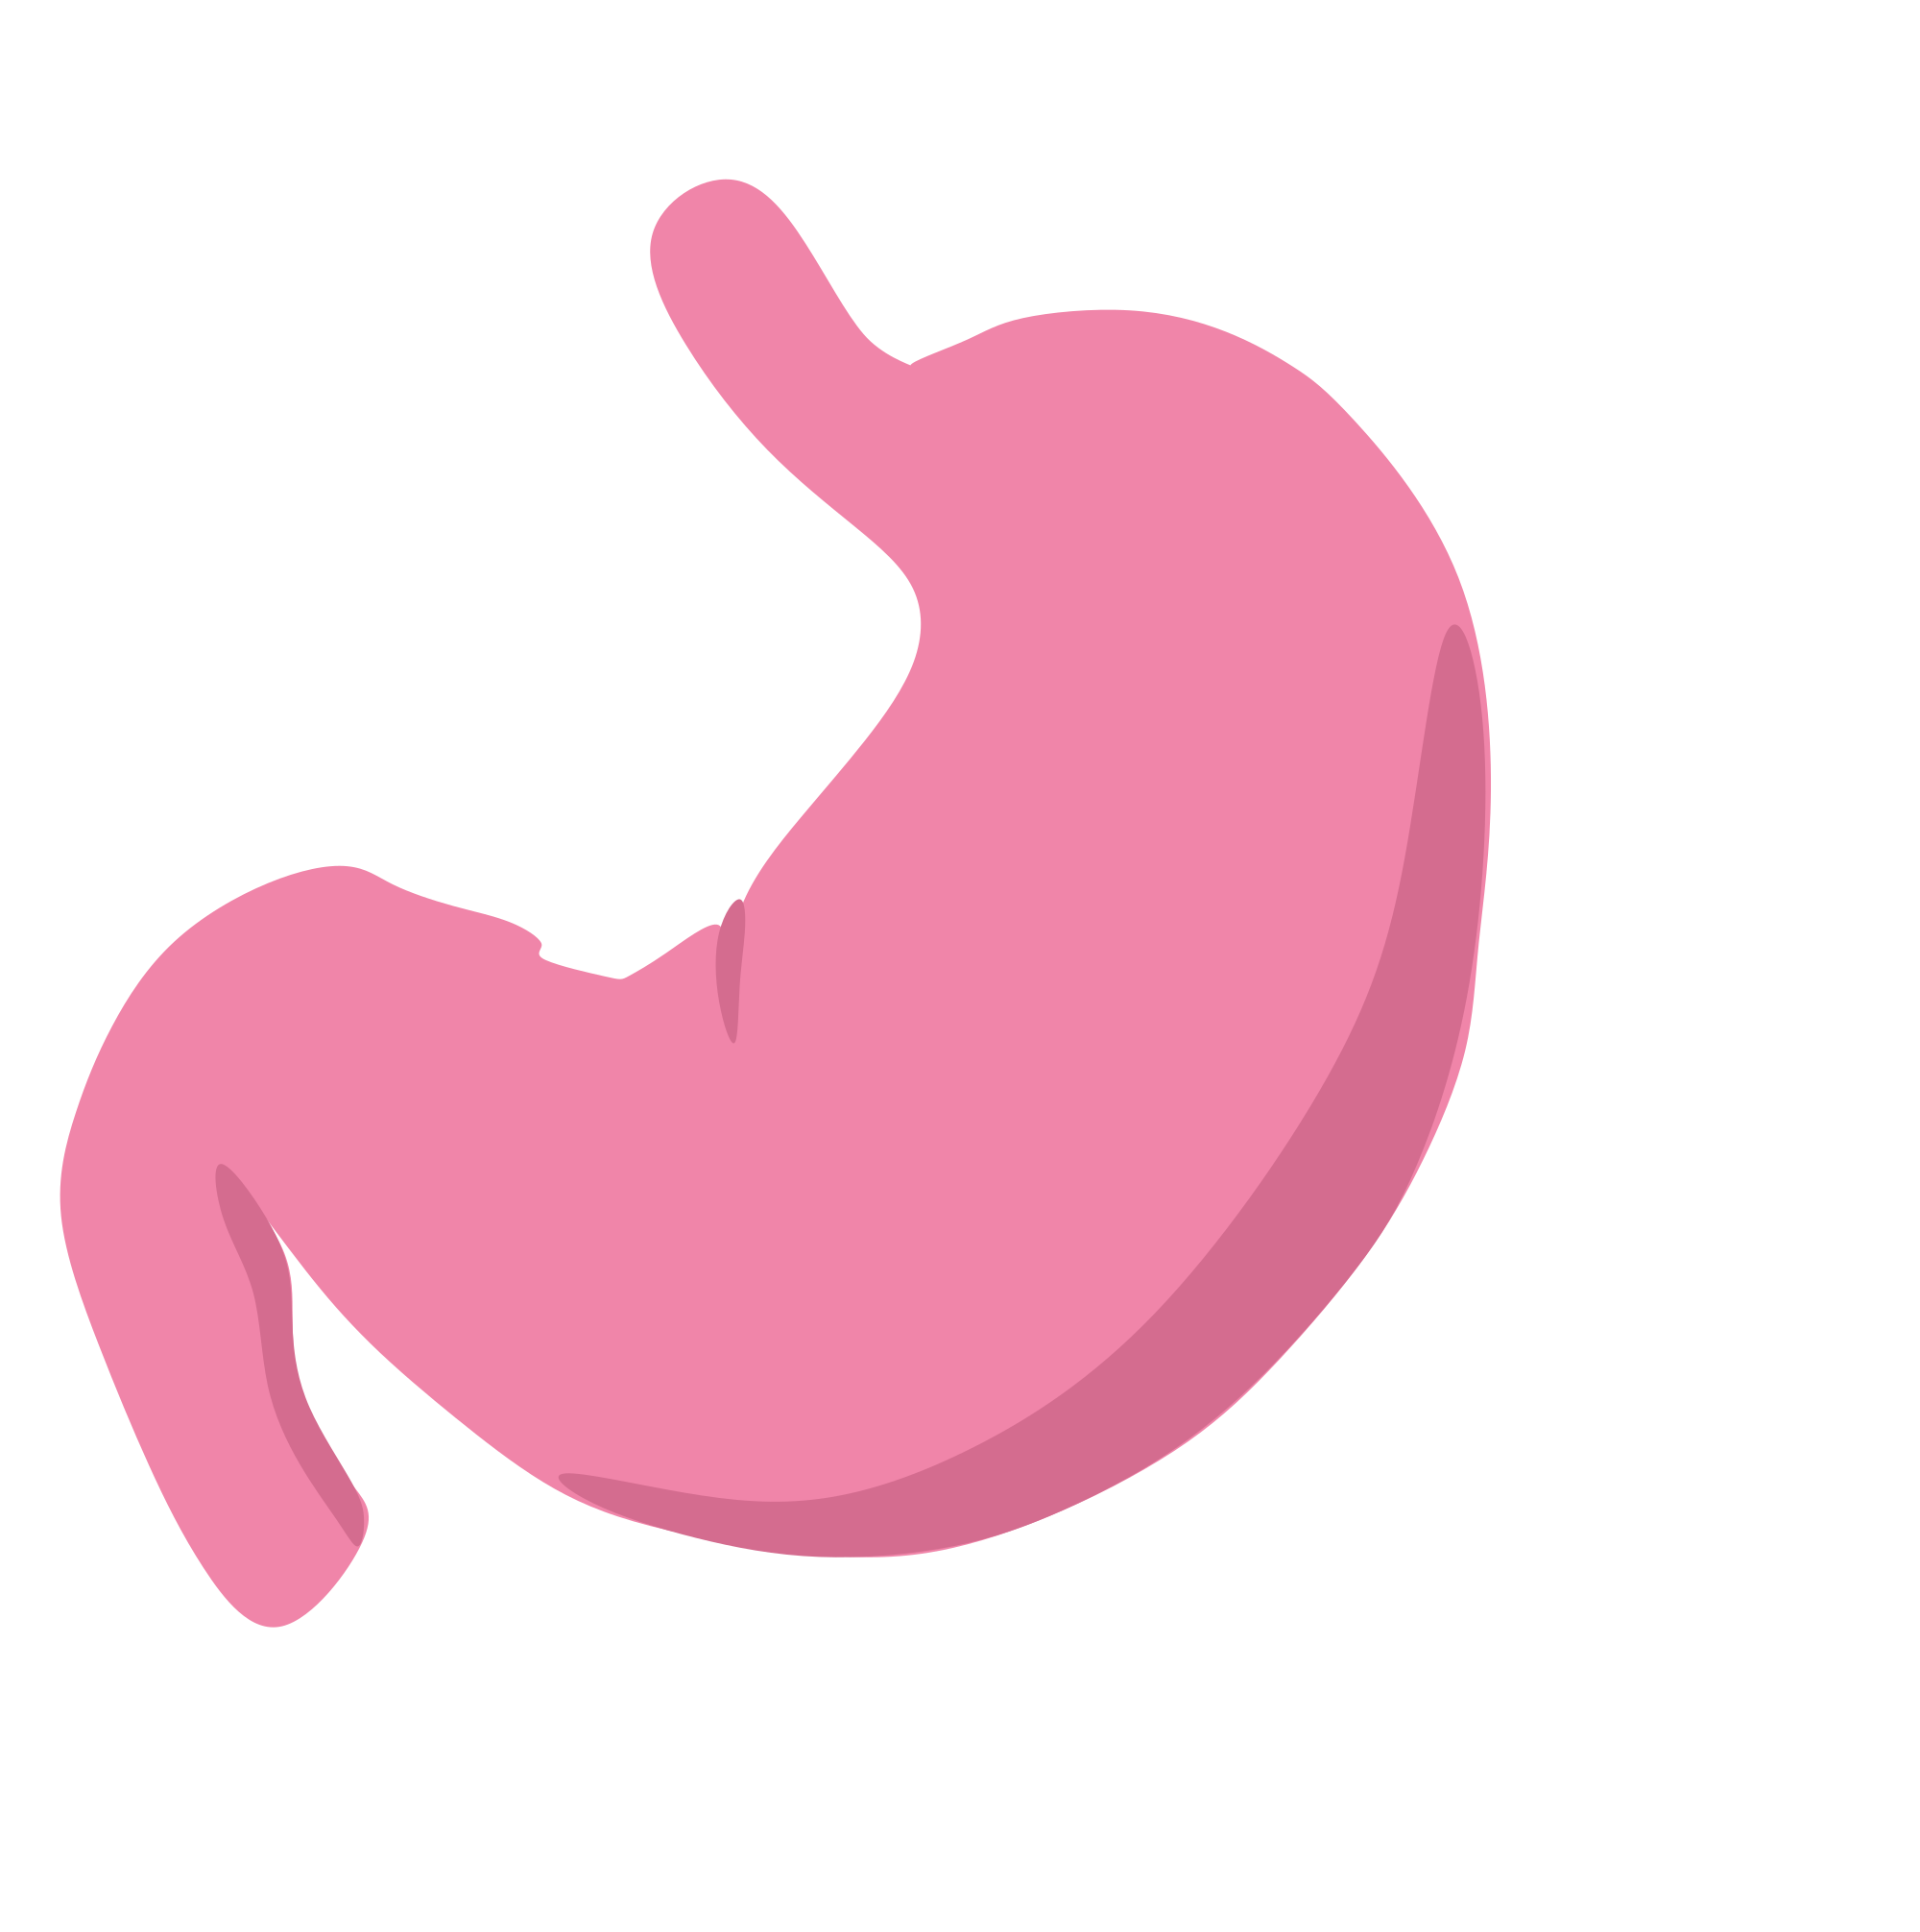
Natural Barriers
Skin
Respiratory System
Gastrointestinal System
Immune System

Slide 5
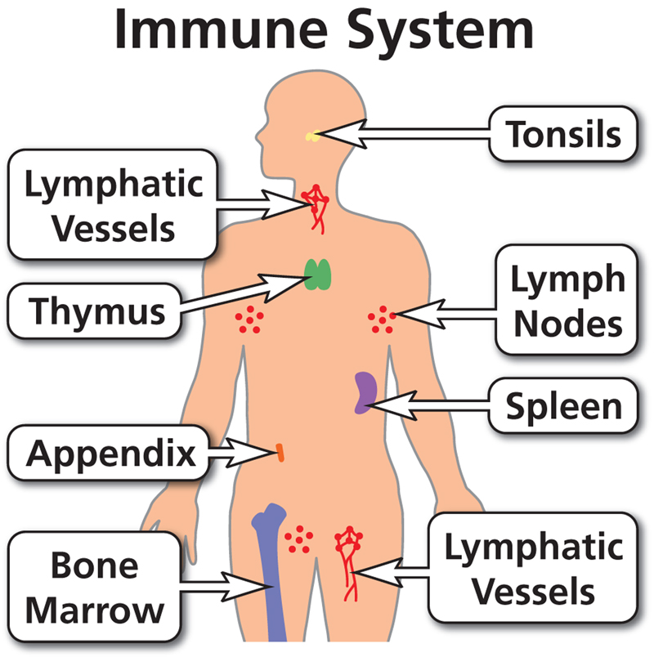

Slide 6
The Immune System
Protects against diseases and illnesses caused by bacteria and viruses.
Made up of specialized organs, cells, and tissues that work together to destroy these “invaders”.
The process of the body fighting off “invaders” is called the immune response.

Slide 7
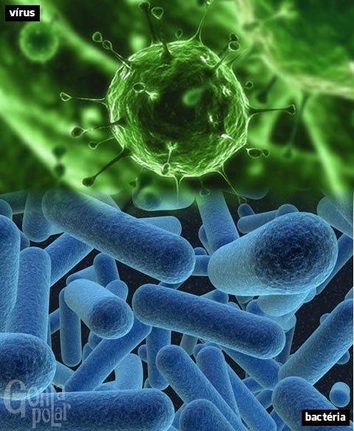

Slide 8
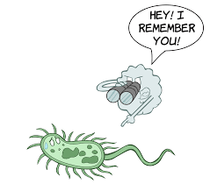
How do we get immunity?
Natural Immunity - developed at birth
Acquired Immunity - exposure to an “invader”/immunization (example:chicken pox)

Slide 9
BloodBORNE PAthogens
Hepatitis C
Hepatitis B
HIV/AIDS
*These pathogens are transmitted by blood to blood contact or exposure to other body fluids.

Slide 10
HIV
Human
Immunodeficiency
Virus

Slide 11
AIDS
Acquired
Immunodeficiency
Syndrome

Slide 12
Facts about HIV/AIDS
It is carried in the blood of someone that has the virus.
Once someone has HIV/AIDS - they have it for the rest of their life! There is no cure!
There are medicines that can help to prolong a person’s life that has HIV/AIDS.
HIV/AIDS affects a person’s immune system.They may get infections that a healthy person would be able to fight off.

Slide 13
You CanNot get AIDS from...
Drinking from a water fountain after someone with HIV/AIDS
Swimming in the same pool with someone that has HIV/AIDS
Shaking hands with someone that has HIV/AIDS
Being in the room with someone that has HIV/AIDS
Donating blood or receiving a transfusion.
HIV/AIDS is not carried in saliva, tears, sweat, or urine.

Slide 14
What Would You Do?
What would you do if someone you are with was hurt and bleeding?
How would you protect yourself?
Why do you need to protect yourself?
Universal Precautions

Slide 15
People for accurate information
Parents
Teachers
Doctors and Nurses
Friends??

Slide 16
Important to Remember!
Avoid catching illnesses and diseases by:
Wash your hands!
Clean out cuts and scrapes!
Do not share food or drink with someone who is sick!
Protect yourself from other’s blood!
Keep your immune system strong by keeping your body healthy!

Slide 17
QUESTIONS?

Slide 18
References
https://www.ducksters.com/science/biology/immune_system.php
The Immune System: Doing Its Part, Marsh Media (Item #9553D)

